Slide 1

VendBridge Project Analysis For NexaLink Presented by Esther Bello 2025-04-28

Slide 2

Introduction Project Objective and Scope Process Overview Approach to Analysis Key Insights Growth Trends and Forecasts Regional & Device Insights Usage Patterns Challenges Identified Key Risks Recommendations Strategic Actions Impact Potential Expected Outcomes Action Plan Summary

Slide 3
Introduction
Objective / What We Worked On
Analyze VendBridge app’s user acquisition and engagement data to understand performance.
Identify key trends in growth, usage, and retention metrics.
Detect anomalies in user behavior or app performance (e.g., spikes, drops).
Forecast near-term user activity (30/60/90 days) based on current trends.
Provide clear, actionable recommendations to improve user growth and retention.

Slide 4
Process Overview
Data Collection & Prep: Gathered App Analytics Data (Installs, Sign-ups, Active Users, Etc.) From Recent Months.
Exploratory Analysis: Visualized Key Dashboards (Tableau) Metrics To Establish Baseline Patterns.
Kpi Monitoring: Tracked Core Kpis (DAU, Transactions, Conversion Rate, Churn) Month-over-month For Changes.
Anomaly Detection: For Deeper Investigation, Flagged Unusual Spikes Or Drops (E.G., Crash Rate Surge).
Forecast Modeling: Projected Future User Activity (30/60/90 Days Out) Using Recent Growth Rates And Trends.
Insights & Recommendations: Summarized Findings And Developed Data-driven Recommendations For Improvement.

Slide 5
Key Insights (Growth Trends)
VendBridge’s user base and activity are on a strong upward trajectory. Total app installs reached ~1.98 million (↑9% vs last month) and user sign-ups hit 1.21 million (↑5% MoM). Daily active users averaged around 3,000 in the previous month (about a 6% increase), indicating rising engagement. Churn remained low at ~1.1% (slightly improved from 1.2%), signaling solid overall retention even as the user base grows.
Total App Installs: 1,981,807 (9% month-over-month growth).
Total User Sign-ups: 1,213,484 (5% increase from previous month).
Avg. Daily Active Users: ~3,000 per day (up ~6% vs. last month’s average).
Monthly Churn Rate: ~1.1% of users (stable, slight improvement from 1.2% prior).
Sign-up Conversion: 61.2% of installers convert to sign-up (down from ~63.4% last month).

Slide 6
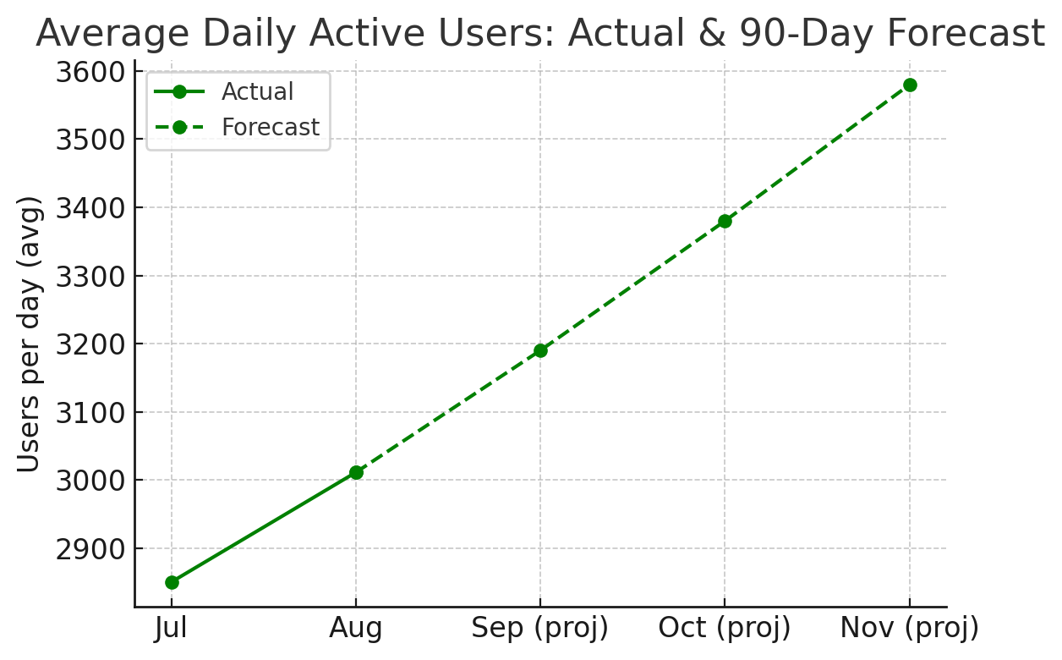
Key Insights (Anomalies & Forecast)
Despite positive growth, a few anomalies were observed. The user sign-up conversion rate dipped from ~63% to 61%, suggesting some friction in the onboarding process.
We also saw a notable spike in app crashes (↑24% month-on-month), likely tied to a recent app update – an outlier that could impact user experience if unaddressed.
On a brighter note, our 90-day forecast is optimistic. If current trends hold, average daily active users are projected to reach ~3,500 (as shown in the chart), and transaction volumes will continue to grow. Addressing the noted anomalies will be key to sustaining this momentum.
Conversion Drop: Sign-up rate fell from ~63% to 61% (fewer new users completing registration than usual).
Stability Issue: Avg. daily app crashes jumped 24% in the last month (an anomaly likely caused by a new release).
Mid-Month Spike: An unusual peak in user activity was observed mid-month (possible campaign or viral event effect).
90-Day Outlook: User activity expected to grow ~5–7% MoM – projecting ~3.5k daily actives in 3 months if trends continue.

Slide 7
Regional & Device Insights
User engagement is well-distributed across regions and platforms. The US leads in activity (slightly ahead of other regions), followed by strong usage in EMEA and Canada, with APAC a bit lower but growing. On the platform side, the user base is almost evenly split between iOS and Android, indicating no major preference – the app performs similarly on both. These insights suggest growth opportunities exist globally and on both platforms, without any single segment dominating the user base or requiring a unique strategy.
Top Region – US: The United States has the highest user activity (leading by ~10–15% over the next region).
Other Regions: EMEA and Canada show robust engagement; APAC is slightly lower but represents growth potential.
Platform Split: ~50% iOS vs 50% Android usage (no significant disparity in engagement by device).
Global Reach: Consistent user experience across regions and platforms – no region or OS is dramatically underperforming.

Slide 8

Summary of Challenges
Onboarding Friction: The drop in sign-up conversion suggests some new users do not complete registration – indicating an issue in the onboarding flow or value proposition.
App Stability Concerns: A surge in crash reports (↑24%) could frustrate users, risking higher churn if not resolved quickly. Ensuring app reliability is becoming critical as the user base grows.
Retention Pressure: Churn is low at ~1%, but even a slight uptick can impact growth at scale. Maintaining engagement and satisfaction is essential to prevent loss of hard-won users, especially given the minor decline in conversion and the spike in crashes.

Slide 9
Recommendations
Streamline Onboarding:
Simplify And Optimize The Sign-up Process (Fewer Steps, In-app Guidance). This Will Help Convert More Installers Into Registered Users And Lift The Conversion Rate Back Up.
Improve App Stability:
Prioritize Fixing Crash-related Bugs Immediately And Bolster Qa Testing For New Releases. Reducing Crashes Will Protect The User Experience And Trust.
Boost Engagement: Introduce New Engagement Features Or Incentives (E.G. Personalized Content, Notifications, Loyalty Rewards) To Keep Users Active And Increase Time Spent In The App.
Target Apac Growth: Launch Localized Marketing Campaigns And App Content For Apac Region To Capitalize On Its Growth Potential, Since Usage There Is Slightly Lagging Other Regions.
Monitor & Iterate: Implement Ongoing Monitoring (Set Up Alerts For Anomaly Spikes) And Gather User Feedback Regularly. Use This Data To Continually Refine The User Experience And Address Issues Before They Escalate.

Slide 10
Potential Impact (if Recommendations Implemented)
Higher Conversion Yield: If sign-up rate improves by ~4% (back to ~65%), that could translate to ~50,000 additional new users in the next month (given current install rates).
Retention Gain: By fixing crashes and improving stability, we may prevent an estimated 5–10% of users from churning due to frustration, compounding user growth over time.
Engagement Uplift: New features and incentives could boost daily active users by ~10% (reaching ~3,300+ DAU soon) and increase average time spent per user.
Regional Expansion: Focusing on APAC could drive a +15% increase in new installs from that region in the next quarter, adding significantly to the global user base.
Overall Growth: These improvements position VendBridge to accelerate user growth and engagement, exceeding our current forecast and strengthening its market presence.

Slide 11

Implement Changes: Execute the recommended fixes and improvements (deploy an app update to resolve crashes, refine the onboarding flow, roll out new engagement features). Monitor Metrics: Closely track key metrics post-implementation – especially sign-up conversion, crash rate, DAU, and churn – to gauge the impact of changes. A/B Testing: Run A/B tests for onboarding tweaks and new features to measure what works best and ensure improvements are data-driven quantitatively. Follow-Up Analysis: Schedule a review in 3 months to compare actual metrics against forecasts. Adjust the strategy based on results and promptly identify new opportunities or issues. Continuous Feedback: Establish a feedback loop with users (surveys, app ratings) and an anomaly alert system, so the team can respond quickly and keep improving the user experience.

Slide 12

Summary
Vendbridge Has Achieved Substantial User Growth, Increasing App Installs And Daily Engagement Over The Past Three Months. Daily Active Users (DAU) And Time Spent Per User Continue To Trend Upward.
However, A Slight Drop In Sign-up Conversion And A Spike In App Crashes Were Identified As Key Risks. Addressing These Challenges Will Help Sustain Growth, Improve User Retention, And Strengthen The App’s Overall Performance.

Slide 13

This Photo by Unknown Author is licensed under CC BY-SA

